Slide 1
AUTOMATION INVIGILATION DUTIES

Slide 2
INDEX
Abstract
Objective of project
Problem Statement
Scope & Motivation
Introduction
Literature survey
Existing Method
Disadvantages
Proposed method
Advantages
Project Flow
Hardware and Software Requirements
Architecture
Modules
UML Diagram
References

Slide 3
ABSTRACT
Pre-requisite for conduct of Examination viz competitive school and college level exams, entrance exams etc. requires faculty or staff members to perform invigilation duty. Preparation of invigilation duty list is a tedious work if done manually when large number of invigilators is involved for examination scheduled daily in two or more shifts for large number of days. Here we have discussed development of an automated system that can generate invigilation duty list for any type examination. This automated system will take some required data like staff list, dates of examinations and number of invigilators on the days, as input and, gives the invigilation duty list as output according to fed data.

Slide 4
ABSTRACT
It can be useful for any organization, universities, institutes where examinations are held. One can reduce the time wasted in making the invigilation duty list manually using this automated system.
Keywords: Examination, Invigilation, Invigilator, Duty List.

Slide 5
OBJECTIVE OF PROJECT
“Automation Invigilation Duties” is software developed for maintaining the invigilation information of the exam. The objective of automation invigilation duties management is to provide a user-friendly and efficient platform that enables faculty to access relevant and up-to-date information about their exam details, check the details by individually who are going exam hall for invigilation.

Slide 6
PROBLEM STATEMENT
Automation invigilation duties is software developed for invigilation duties in all colleges. It facilitates to access the invigilation information of a particular faculty . By just a click on the mouse, the system will be able to produce the invigilation duties report thus reducing the need for work searching somewhere which is prone to human errors and time consuming.

Slide 7
SCOPE AND MOTIVATION
Motivation:- Now a days faculty who are going to invigilation they are finding rooms physically and in the examination section .Here in our application faculty can see in at time invigilation duties. In that information details like date, subject and timings all the information quickly in online will get information.
Scope:- The scope of the project is the system on which the software is installed, i.e, the project is developed as a desktop application. Overall, the scope of automation invigilation duties systems can be quite extensive, and they can provide significant benefits to invigilation information ,date of the particular day and subject details ,timings .

Slide 8
INTRODUCTION
Preparing the examination invigilation schedule has always been in itself a challenging task as the examination department has to take into consideration numerous factors and lecturers’ constraints such as getting the invigilation schedules ready within a limited time frame, ensuring the invigilation duties assigned to the lecturers do not disrupt their marking and that the lecturers do not invigilate their own subjects.
As the invigilation duties were assigned randomly there was a lot of mutual swapping amongst the lecturers resulting in confusion, misunderstandings, and complaints on uneven duty distribution

Slide 9
INTRODUCTION
Thus, when the present invigilation scheduling committee took over the task of invigilation scheduling , they saw the need for a systematic and yet innovative approach to producing invigilation schedules that could minimize errors and simultaneously allowed lecturers to request for their preferred invigilation dates and time.

Slide 10
LITERATURE SURVEY
S.NO | YEAR | AUTHORS | TITLE | OUT COMES
1 | 2017 | S. Priya Dharshini, M. Selva Sudha, Mrs. V. Anithalakshmi | Exam Cell Automation System,” International Journal of Engineering Science and Computing | In this paper, As the examination arrives there exists a lot of work like consolidating the time table,
2 | 2015 | Dayanand G Savakar, Ravi Hosur | Automation of Examination System | In this paper, An automated system can be used through cloud computing technology that facilitates the every college to provide their student and staff information and get the results of allotment.

Slide 11
LITERATURE SURVEY
S.NO | YEAR | AUTHORS | TITLE | OUT COMES
3 | 2012 | C.Chung-Hua, H. Chenyang | Best Practices for implementing Fingerprint Biometrics in Application | In this paper, The method also includes evaluating the metadata and selecting one or more nodes from the most recently matched template for comparison.
4 | 2012 | Josphineleela R. and Ramakrishnan M | International Journal of Computer Science and Information Security, | used to automate the whole process of taking attendance, manually which is a laborious and troublesome work and waste a lot of time, with its managing and maintaining the records for a period of time is also a burdensome task.

Slide 12
LITERATURE SURVEY
S.NO | YEAR | AUTHORS | TITLE | OUT COMES
5 | 2014 | Indu Sharma, Anjali Singhal | Research on Online Examination System, , International Journal of Engineering Technology, | In this paper: , techniques have been proposed to automate the time table generation, automatic paper setting and evaluation
6 | 2006 | Ong, M. L., Liew, L. H. and Sim, J | Examination Invigilation Scheduling System In Optimising Lecture | In this paper, This is made possible with the creation of a database that collects information pertaining to the examinations invigilation

Slide 13
LITERATURE SURVEY
It is facilitated to access the performance and information of exam hall details for faculty who are going for invigilation.
This system will be useful for invigilator who want go to exam halls, they can visit our application without any doubts all the information for getting invigilation duties.
Use remote invigilation technology: Remote invigilation technology could allow invigilators to monitor exams remotely. This could save time and resources by allowing multiple exams to be monitored simultaneously.

Slide 14
EXISTING SYSTEM
In the present scenario, the task of invigilation scheduling involves all the lecturing staff who follows a set of invigilation schedule that is prepared manually by the examination department in the college. However, a lot of tasks are required in order to organize an examination from the college such as assigning a set of proctors to each examination room and assigning a seating layout for each examination room. These tasks usually involve a lot of data from many sources and require more time

Slide 15
DISADVANTAGES
1. Not User Friendly: The existing system is not user friendly because the retrieval of data is very slow and data is not maintained efficiently.
2. Difficulty in report generating: We can’t able see the all the invigilation information. And the faculty not get at the time of searching for exam hall
3. Time consuming: Every work is done manually so we cannot get the information in the middle of the tour or as per the requirement because it is very time consuming.

Slide 16
PROPOSED METHOD
The propose system is highly automated and makes the invigilation information much easier and flexible. The faculty can get the very right information at the very right time. The system is expected to increase the efficiency in the allocation rooms to the faculty members who are going to invigilate during the examination. Therefore, it will decrease the work hours and manpower.

Slide 17
ADVANTAGES
1. User Friendly: - The proposed system is user friendly because the retrieval and storing of data is fast and data is maintained efficiently. Moreover the graphical user interface is provided in the proposed system, which provides user to deal with the system very easily.
2. Reports are easily generated: reports can be easily generated in the proposed system so user can get information at anytime

Slide 18
ADVANTAGES
3. Very less work: The proposed system requires very less work. All the data is fetched into the computer immediately and reports can be generated through computers. Moreover work becomes very easy because there is no need to keep data on papers.
4. Computer operator control: Computer operator control will be there so no chance of errors. Moreover storing and retrieving of information is easy. So work can be done speedily and in time.

Slide 19
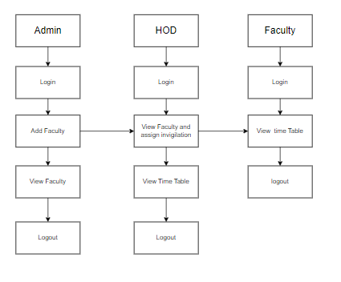
PROJECT FLLOW
Figure: work Flow of Proposed system

Slide 20
HARDWARE & SOFTWARE REQUIREMENTS
SOFTWARE REQUIREMENS
Operating System : Windows 7/8/10
Server side Script : HTML, CSS, & JS
Programming Language : JAVA
IDE/Workbench : Intellij IDEA

Slide 21
HARDWARE & SOFTWARE REQUIREMENTS
SOFTWARE REQUIREMENS
Technology : Java 1.7
Server Deployment : Tomcat Server
Database : MySQL

Slide 22
HARDWARE & SOFTWARE REQUIREMENTS
HARDWARE REQUIREMENTS
Processor - I3/Intel Processor
RAM - 4GB (min)
Hard Disk - 128 GB
Key Board - Standard Windows Keyboard
Mouse - Two or Three Button Mouse
Monitor - Any

Slide 23
FUNCTIONAL AND NON-FUNCTIONAL REQUIREMENTS
Requirement’s analysis is very critical process that enables the success of a system or software project to be assessed. Requirements are generally split into two types: Functional and non-functional requirements.
Functional Requirements: These are the requirements that the end user specifically demands as basic facilities that the system should offer. All these functionalities need to be necessarily incorporated into the system as a part of the contract. These are represented or stated in the form of input to be given to the system, the operation performed and the output expected. They are basically the requirements stated by the user which one can see directly in the final product, unlike the non-functional requirements.

Slide 24
FUNCTIONAL AND NON-FUNCTIONAL REQUIREMENTS
Examples of functional requirements:
Authentication of user whenever he/she logs into the system
System shutdown in case of a cyber-attack
A verification email is sent to user whenever he/she register for the first time on some software system.
Non-functional requirements: These are basically the quality constraints that the system must satisfy according to the project contract. The priority or extent to which these factors are implemented varies from one project to other. They are also called non-behavioral requirements.

Slide 25
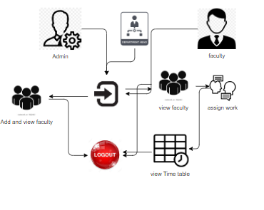
ARCHITECTURE

Slide 26
REFERENCES
[1] S. Priya Dharshini, M. Selva Sudha, Mrs. V. Anithalakshmi, “Exam Cell Automation System,” International Journal of Engineering Science and Computing (2017), Volume 7, Issue no3.
[2] Dayanand G Savakar, Ravi Hosur, “Automation of Examination System”, International Journal of Science and Research, Volume 4 Issue 11 November 2015.
[3] DigitalPersona Incorporation (2012), Best Practices for implementing Fingerprint Biometrics in Application. A Whitepaper

Slide 27
REFERENCES
[4] Josphineleela R. and Ramakrishnan M. (2012). An efficient Automatic system using Fingerprint Reconstruction Technique. International Journal of Computer Science and Information Security, 10(3):1-6
[5] Indu Sharma, Anjali Singhal, Research on Online Examination System, International Journal of Engineering Technology, Management and Applied Sciences,Volume 2 Issue 3, August 2014
[6] Ong, M. L., Liew, L. H. and Sim, J. (2006). Examination Invigilation Scheduling System In Optimising Lecturers’ Preference. UiTM Sarawak: Unit of Research, Development, and Commercialization (URDC), Sarawak: University Teknologi Mara

Slide 28
UML DIAGRAMS
Use Case Diagram:
A use case diagram in the Unified Modeling Language (UML) is a type of behavioral diagram defined by and created from a Use-case analysis. Its purpose is to present a graphical overview of the functionality provided by a system in terms of actors, their goals (represented as use cases), and any dependencies between those use cases. The main purpose of a use case diagram is to show what system functions are performed for which actor. Roles of the actors in the system can be depicted.

Slide 29
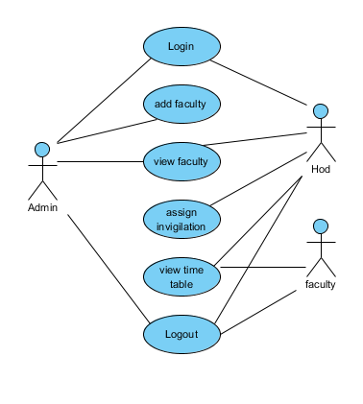
UML DIAGRAMS
Figure: Use Case Diagram

Slide 30
UML DIAGRAMS
Class Diagram:
In software engineering, a class diagram in the Unified Modelling Language (UML) is a type of static structure diagram that describes the structure of a system by showing the system's classes, their attributes, operations (or methods), and the relationships among the classes. It explains which class contains information.

Slide 31
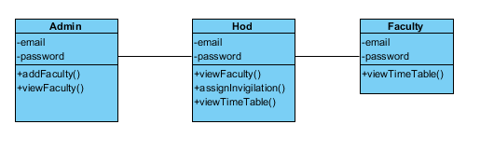
UML DIAGRAMS
Figure: Class diagram

Slide 32
UML DIAGRAMS
Sequence Diagram:
A sequence diagram in Unified Modelling Language (UML) is a kind of interaction diagram that shows how processes operate with one another and in what order. It is a construct of a Message Sequence Chart. Sequence diagrams are sometimes called event diagrams, event scenarios, and timing diagrams.

Slide 33
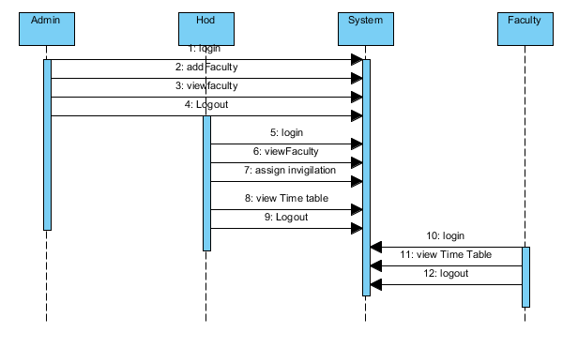
UML DIAGRAMS
Figure: Sequence diagram

Slide 34
UML DIAGRAMS
Collaboration Diagram:
In collaboration diagram the method call sequence is indicated by some numbering technique as shown below. The number indicates how the methods are called one after another. We have taken the same order management system to describe the collaboration diagram. The method calls are similar to that of a sequence diagram. But the difference is that the sequence diagram does not describe the object organization whereas the collaboration diagram shows the object organization.

Slide 35
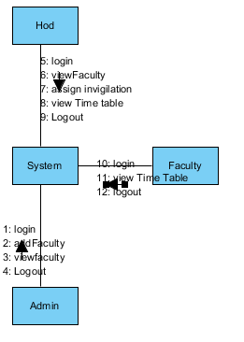
UML DIAGRAMS
Figure: Collaboration diagram

Slide 36
UML DIAGRAMS
Deployment Diagram
Deployment diagram represents the deployment view of a system. It is related to the component diagram. Because the components are deployed using the deployment diagrams. A deployment diagram consists of nodes. Nodes are nothing but physical hardware’s used to deploy the application.

Slide 37
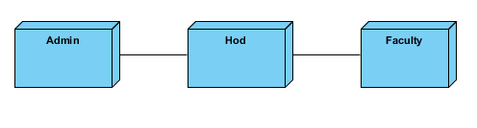
UML DIAGRAMS
Figure: Deployment diagram

Slide 38
UML DIAGRAMS
Activity Diagram:
Activity diagrams are graphical representations of workflows of stepwise activities and actions with support for choice, iteration and concurrency. In the Unified Modelling Language, activity diagrams can be used to describe the business and operational step-by-step workflows of components in a system. An activity diagram shows the overall flow of control.

Slide 39
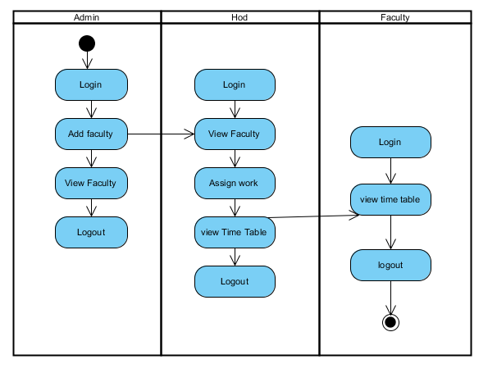
UML DIAGRAMS
Figure: Activity diagram

Slide 40
UML DIAGRAMS
Component Diagram:
A component diagram, also known as a UML component diagram, describes the organization and wiring of the physical components in a system. Component diagrams are often drawn to help model implementation details and double-check that every aspect of the system's required functions is covered by planned development.

Slide 41
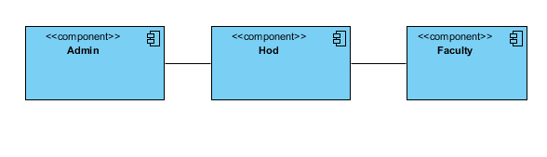
UML DIAGRAMS
Figure: Component diagram

Slide 42
UML DIAGRAMS
ER Diagram:
An Entity–relationship model (ER model) describes the structure of a database with the help of a diagram, which is known as Entity Relationship Diagram (ER Diagram). An ER model is a design or blueprint of a database that can later be implemented as a database. The main components of E-R model are: entity set and relationship set.
An ER diagram shows the relationship among entity sets. An entity set is a group of similar entities and these entities can have attributes. In terms of DBMS, an entity is a table or attribute of a table in database, so by showing relationship among tables and their attributes, ER diagram shows the complete logical structure of a database. Let’s have a look at a simple ER diagram to understand this concept.

Slide 43
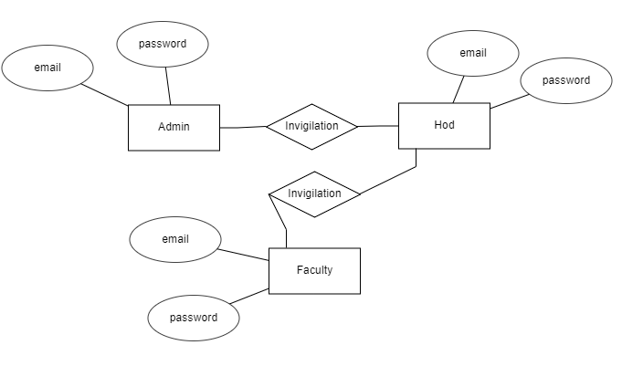
UML DIAGRAMS
Figure: ER diagram

Slide 44
UML DIAGRAMS
DFD Diagram:
A Data Flow Diagram (DFD) is a traditional way to visualize the information flows within a system. A neat and clear DFD can depict a good amount of the system requirements graphically. It can be manual, automated, or a combination of both. It shows how information enters and leaves the system, what changes the information and where information is stored. The purpose of a DFD is to show the scope and boundaries of a system as a whole. It may be used as a communications tool between a systems analyst and any person who plays a part in the system that acts as the starting point for redesigning a system.

Slide 45
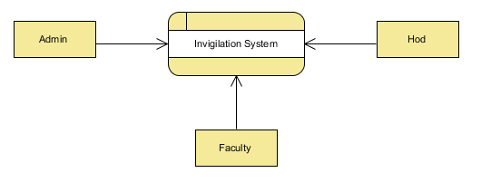
UML DIAGRAMS
Figure: Context Level diagram

Slide 46
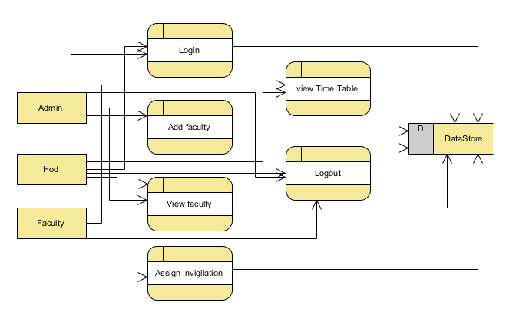
UML DIAGRAMS
FigureLevel-1 diagram

Slide 47
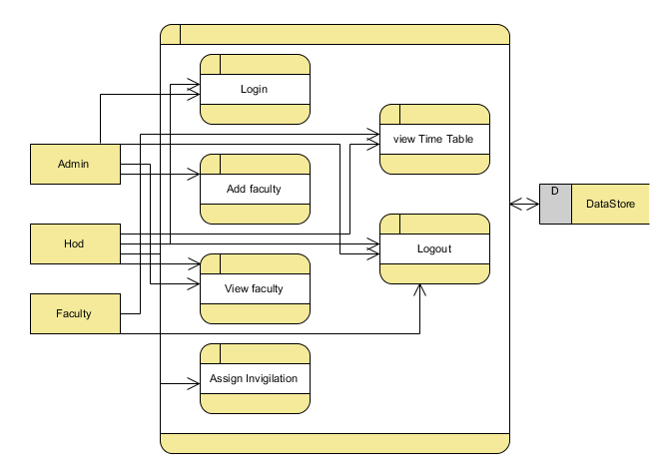
UML DIAGRAMS
Figure:Level-2 diagram

Slide 48
REFERENCES
[1] S. Priya Dharshini, M. Selva Sudha, Mrs. V. Anithalakshmi, “Exam Cell Automation System,” International Journal of Engineering Science and Computing (2017), Volume 7, Issue no3.
[2] Dayanand G Savakar, Ravi Hosur, “Automation of Examination System”, International Journal of Science and Research, Volume 4 Issue 11 November 2015.
[3] DigitalPersona Incorporation (2012), Best Practices for implementing Fingerprint Biometrics in Application. A Whitepaper

Slide 49
REFERENCES
[4] Josphineleela R. and Ramakrishnan M. (2012). An efficient Automatic system using Fingerprint Reconstruction Technique. International Journal of Computer Science and Information Security, 10(3):1-6
[5] Indu Sharma, Anjali Singhal, Research on Online Examination System, International Journal of Engineering Technology, Management and Applied Sciences,Volume 2 Issue 3, August 2014
[6] Ong, M. L., Liew, L. H. and Sim, J. (2006). Examination Invigilation Scheduling System In Optimising Lecturers’ Preference. UiTM Sarawak: Unit of Research, Development, and Commercialization (URDC), Sarawak: University Teknologi Mara

